Slide 1

Netflix
Content
Dashboard
Presented by- Ankita Kheto

Slide 2
Introduction
Background of the dataset:
.
The dataset used in this project contains detailed information about movies and TV shows available on Netflix. It includes features such as title, type, director, cast, country, release year, rating, duration, and genre . The main objective is to analyze Netflix content to understand trends in movie and TV show production, popular genres, ratings, and release patterns over the years.
.
Significance of the study:
.
This study helps to understand how Netflix’s content library has evolved over time and what type of content attracts more audiences . It provides insights into the distribution of movies and TV shows, their ratings, and duration patterns, which can help content creators, analysts, and marketers make data-driven decisions . Overall, it highlights Netflix’s global content diversity and changing entertainment trends.

Slide 3
Problems statement
.
Shows the percentage of Movies vs TV Shows.
.
Displays the most common genres on Netflix.
.
Compares average duration across content ratings.
.
Shows how many titles were released in each year range.
.
Represents the percentage share of different content ratings.

Slide 4
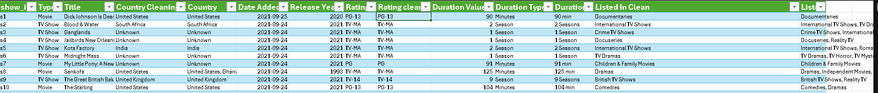
Dataset Description
This dataset contains information about movies and TV shows available on Netflix. It includes details such as title, type, country, release year, date added, rating, duration, and genre. The data was cleaned by correcting missing values, merging columns, and standardizing text formats for accurate analysis.

Slide 5
Average Duration by Rating
Shows how the average duration changes with different content ratings.
Helps identify which ratings (like PG, TV-MA, etc.) have longer or shorter shows.
Useful to understand audience preference based on content length and rating type.

Slide 6
Content Type Breakdown
Shows the overall proportion of Movies and TV Shows on Netflix.
Helps understand which type of content dominates the platform.
Useful for comparing viewer interest and Netflix’s focus on each content type..

Slide 7
Listed in Analysis
Shows which genres are most available on Netflix.
Helps identify the most popular or frequently added content categories.
Useful to understand Netflix’s focus areas and audience content preferences.

Slide 8
Count title by Release year
Shows how many titles were released in different years..
Helps identify trends in Netflix content production over time..
Useful to see which years had the highest or lowest number of releases.

Slide 9
Rating Distribution
Shows the percentage of titles under each rating category.
Helps understand the type of audience Netflix targets (kids, teens, or adults).
Useful to analyze content variety and suitability across different age groups.

Slide 10
Key Insights
Point to Highlight:
Most of the content on Netflix is Movies rather than TV Shows
The most common genres are Drama, Comedy, and Action.
Majority of titles were released between 2015–2020.
TV-MA and TV-14 ratings have the highest number of titles.
Netflix mainly targets adult audiences based on rating distribution..

Slide 11
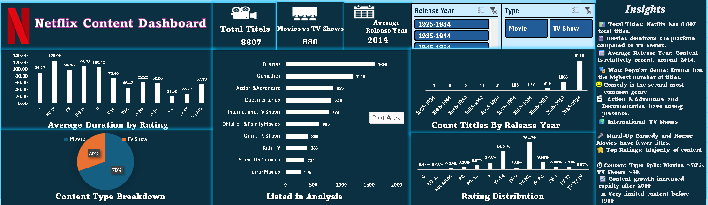
Dashboard Overview

Slide 12
Conclusion
Summary of Findings:
Netflix focuses more on movies than TV shows..
Most titles are rated TV-MA and TV-14, showing content for mature audiences.
Popular genres like Drama and Comedy dominate the platform.
Importance of Action:
Helps Netflix plan and improve its content strategy based on audience trends.
Supports data-driven decisions for future content production and marketing.
Provides insights to enhance user satisfaction and platform engagement.

Slide 13
Thanks

